Slide 1
Power BI Dashboard:
Change Point Detection On Commodity Prices

Slide 2
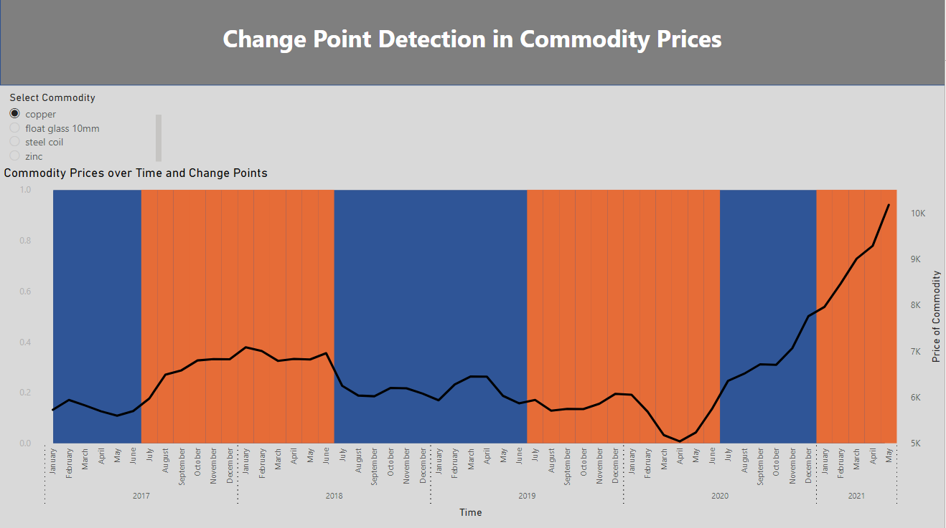
Dashboard View
The goal of this project is to analyze the price of commodities across time and identify when prices have moved so that we can inform pricing decisions for Delta Products.
Try to ignore short term volatility in prices and identify real long term price movement patterns.
We are using Change Point Detection (CPD) algorithm to achieve this objective.
This algorithm looks at the entire dataset of time-series data and groups prices based on performance.
Sections in time where prices have stayed consistent are grouped in sections and a deviation from the consistency causes the algorithm to detect a change point in the time series.

Slide 3
Dashboard View
Options to select the commodity we want to track

Slide 4
Dashboard View
Displays the price of the commodity and points in time where change is detected.

Slide 5
Dashboard View
Displays the price of the commodity and points in time where change is detected.
NOTE: A Change Point is detected when there is a shift in the central point in price from last interval.

Slide 6
Dashboard View
Displays the price of the commodity and points in time where change is detected.
NOTE: A Change Point is detected when there is a shift in the central point in price from last interval.
We are limiting the algorithm to have at least 6 months between 2 points

Slide 7
Dashboard View
Displays the price of the commodity and points in time where change is detected.
NOTE: A Change Point is detected when there is a shift in the central point in price from last interval.
A change in the background color indicated that prices have shifted and could be a signal to review prices of our products.
We are limiting the algorithm to have at least 6 months between 2 points

Slide 8

Running the CPD Analysis
Download the excel file that contains the Commodity Prices data. Also make sure you have the Python file called commodity_run_cpd.py needed to run the process.
Open your terminal.
Use the cd command to go to the location where the python script is stored.
Run the python script as shown in the screen shot below. (use Tab key to autocomplete)
Type python.exe <name of python file> <location of excel file with price data>
This process will create an excel file called commodity.xlsx which is used by Power BI to create the dashboards. Go to Data tab > Edit Query > Data Source > and update the file path for the tables to point to the commodity.xlsx file.
Hit the Refresh Button in Power BI and the new data should be updated in the dashboard.

